Slide 1
Day 3 FDP on Data Science Dimensionality Reduction and Clustering

Slide 2
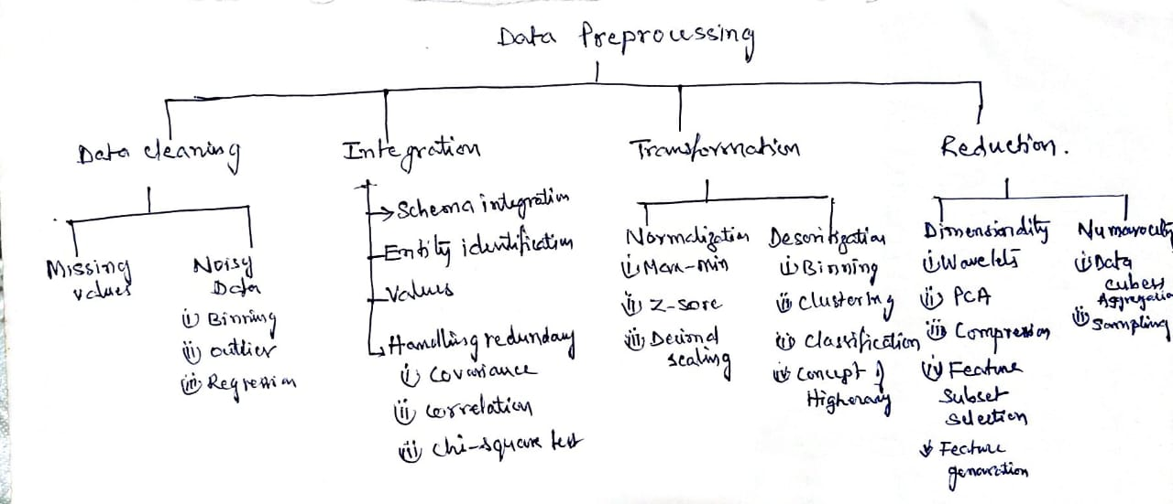

Slide 3
Data Reduction
Data reduction: Obtain a reduced representation of the data set that is much smaller in volume but yet produces the same (or almost the same) analytical results
Why data reduction? — A database/data warehouse may store terabytes of data. Complex data analysis may take a very long time to run on the complete data set.
Data reduction strategies
Dimensionality reduction-remove unimportant attributes/variables
Eliminate the redundant attributes: which are weekly important across the data.
Wavelet transforms/ Data compression
Principal Components Analysis (PCA)
Feature subset selection, feature creation
Numerosity reduction- replace original data volume by smaller forms of data
Regression and Log-Linear Models
Histograms, clustering, sampling
Data cube aggregation

Slide 4
Dimensionality Reduction:
Dimensionality reduction is the process of reducing the number of random variables under consideration, by obtaining a set of principal variables. It can be divided into feature selection and feature extraction.
Problem with high dimensional data?
It can mean high computational cost to perform learning.
It often leads to over-fitting when learning a model, which means that the model will perform well on the training data but poorly on test data.

Slide 5
Methods for Dimensionality Reduction:
Principal Component Analysis (PCA)
Multi Dimensionality Scaling (MDS)

Slide 6
Introduction to PCA
Principal component analysis (PCA) is a statistical procedure that uses an orthogonal transformation to convert a set of observations of possibly correlated variables into a set of values of linearly uncorrelated variables called principal components.
The number of principal components is less than or equal to the smaller of the number of original variables or the number of observations.

Slide 7
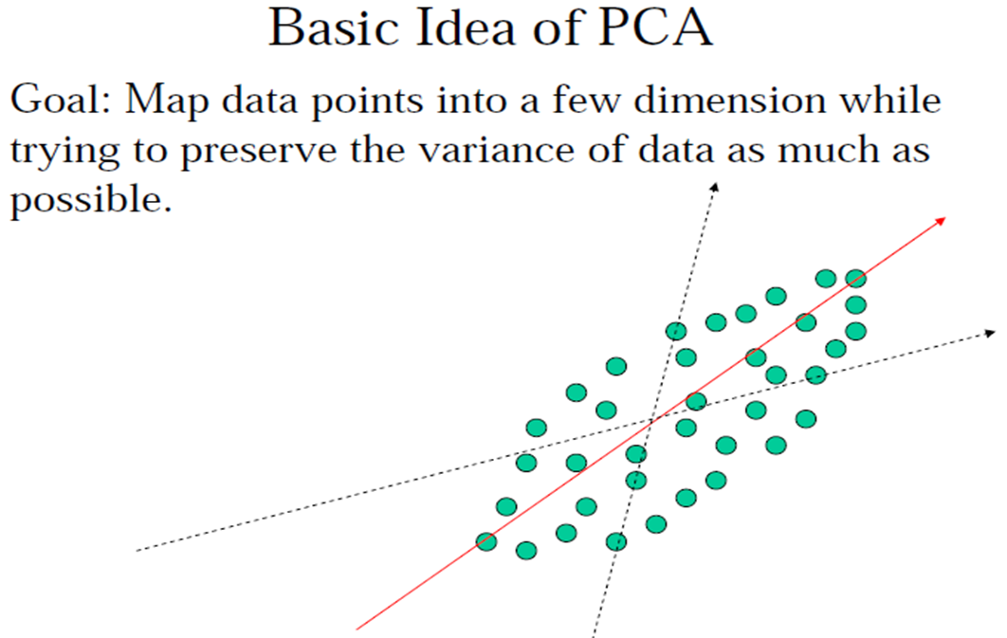
Principal Component Analysis (PCA)
Given N data vectors from d-dimensions, find k ≤ d orthogonal vectors (principal components) that can be best used to represent data
Steps
Normalize input data
Compute k orthonormal (unit) vectors, i.e., principal components
The principal components are sorted in order of decreasing “significance” or strength
Since the components are sorted, the size of the data can be reduced by eliminating the weak components, i.e., those with low variance. (i.e., using the strongest principal components, it is possible to reconstruct a good approximation of the original data)
Used when the number of dimensions is large

Slide 8
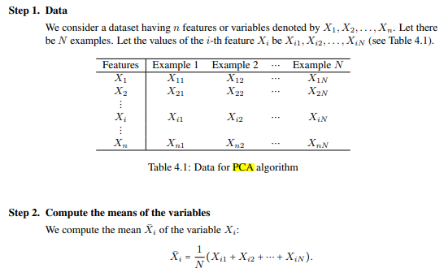
PCA Algorithm

Slide 9
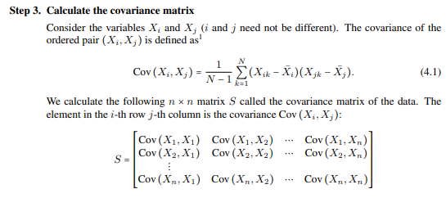
PCA Algorithm

Slide 10
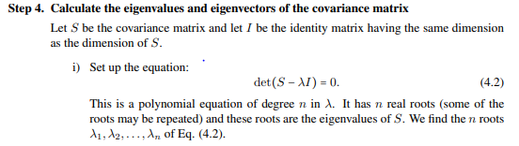
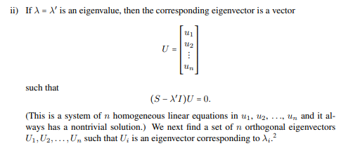
PCA Algorithm

Slide 11
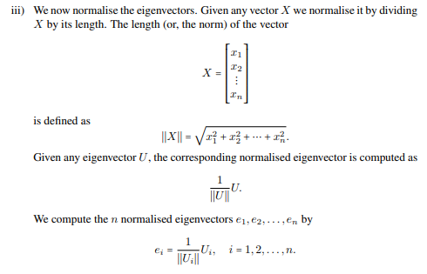
PCA Algorithm

Slide 12
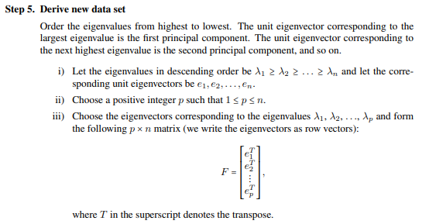
PCA Algorithm

Slide 13
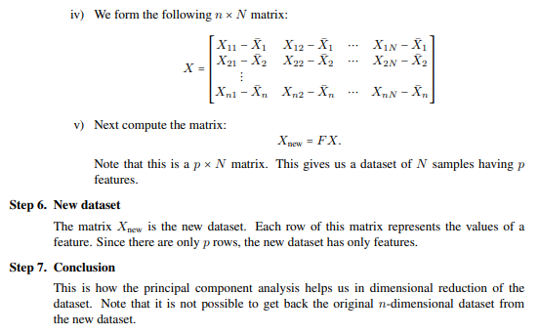
PCA Algorithm

Slide 14
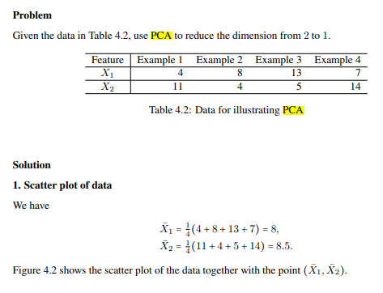
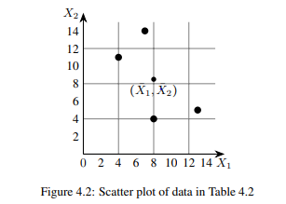
PCA: Example

Slide 15
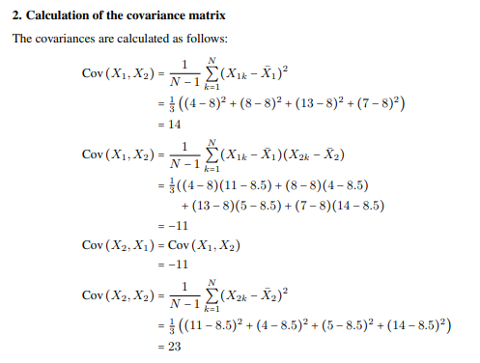
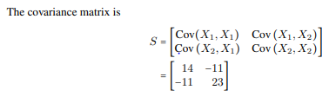
Example

Slide 16
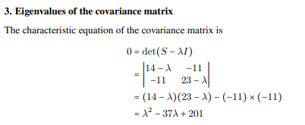

Example

Slide 17
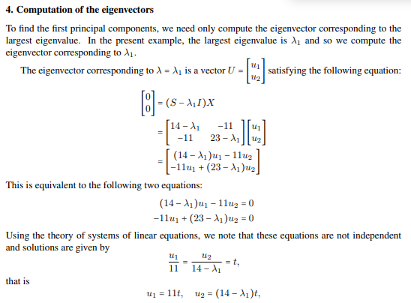
Example

Slide 18
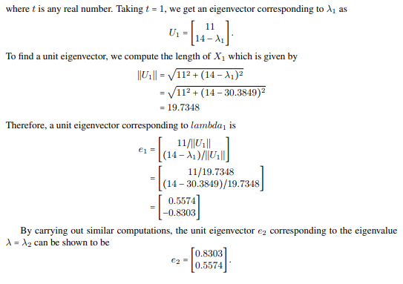
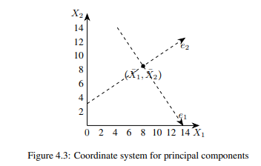
Example

Slide 19
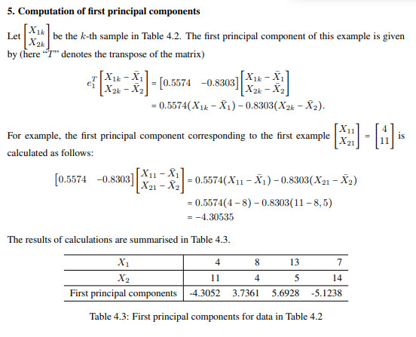
Example

Slide 20
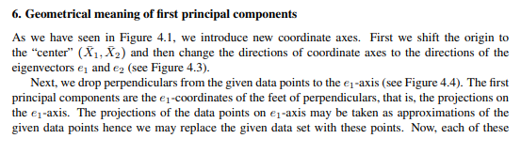
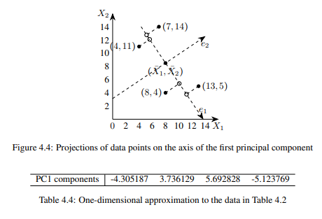
Example

Slide 21
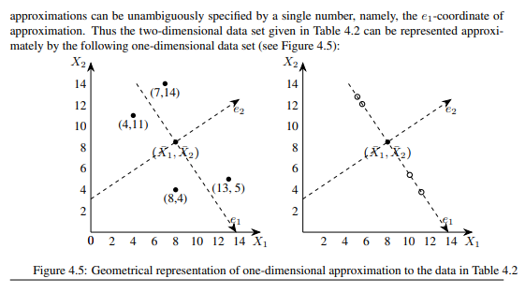
Example

Slide 22
Multi-Dimensional Scaling(PCoA)
Multidimensional scaling (MDS) is a set of statistical techniques used in machine learning to analyze and visualize the similarities and dissimilarities in data.
It's also known as Principal Coordinates Analysis (PCoA)
MDS is a type of non-linear dimensionality reduction.
Used for marketing analysis

Slide 23
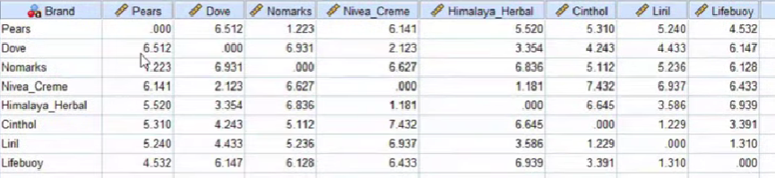
Example: Dimensionality Reduction of Soaps Dataset

Slide 24
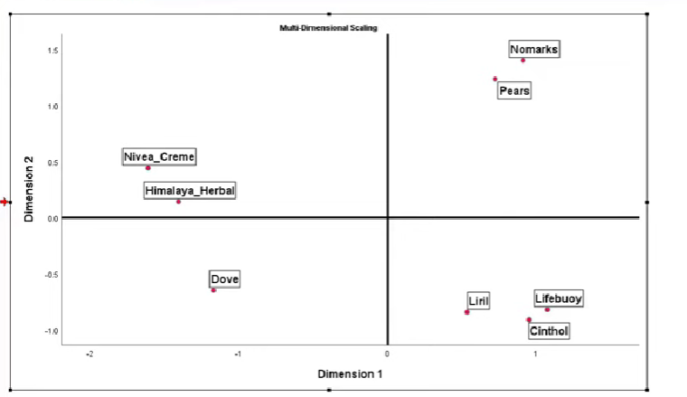

Slide 25
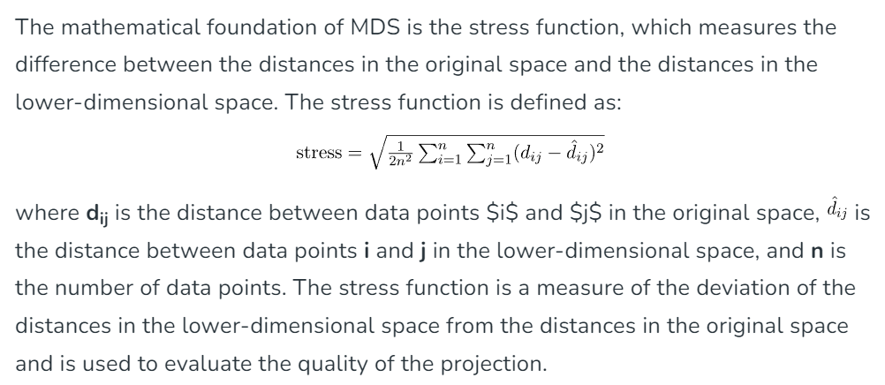

Slide 26
Clustering: Grouping Similar Things
Objects:
Attributes
Population
Sample

Slide 28
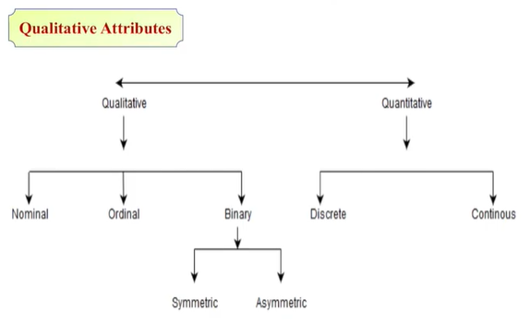
Types of attributes

Slide 29
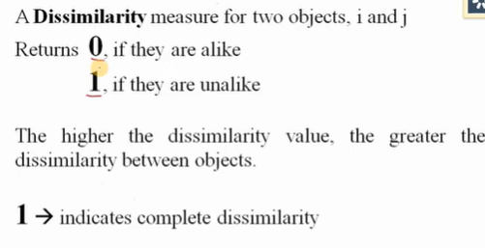
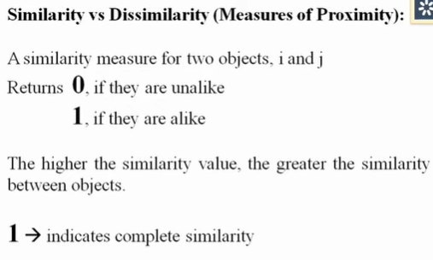
Proximity measures: Similarity and Dissimilarity
Similarity
Proximity: refers to a similarity or dissimilarity

Slide 30
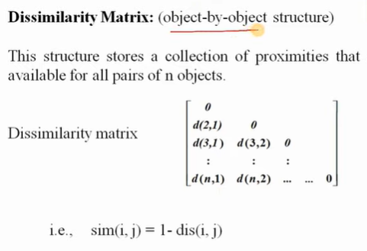
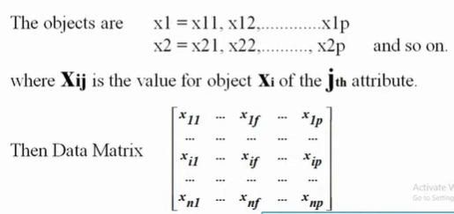
Data Matrix and Dissimilarity Matrix
Data Matrix

Slide 31
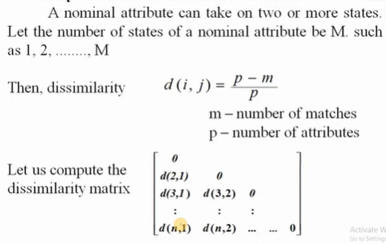
Proximity Measure for Nominal Attributes

Slide 32
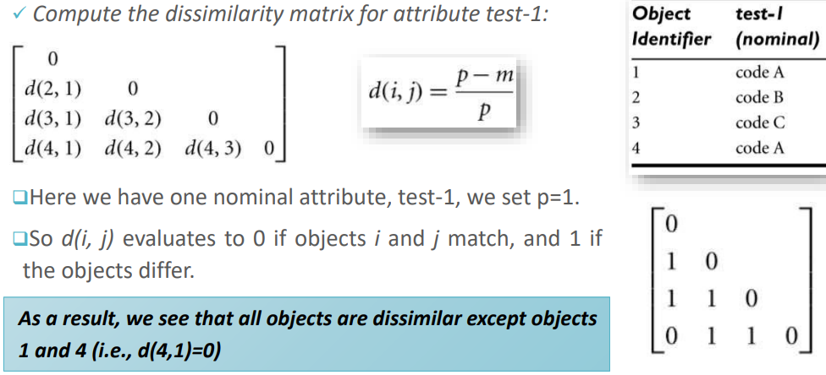
Example : find dissimilarity of given data

Slide 33
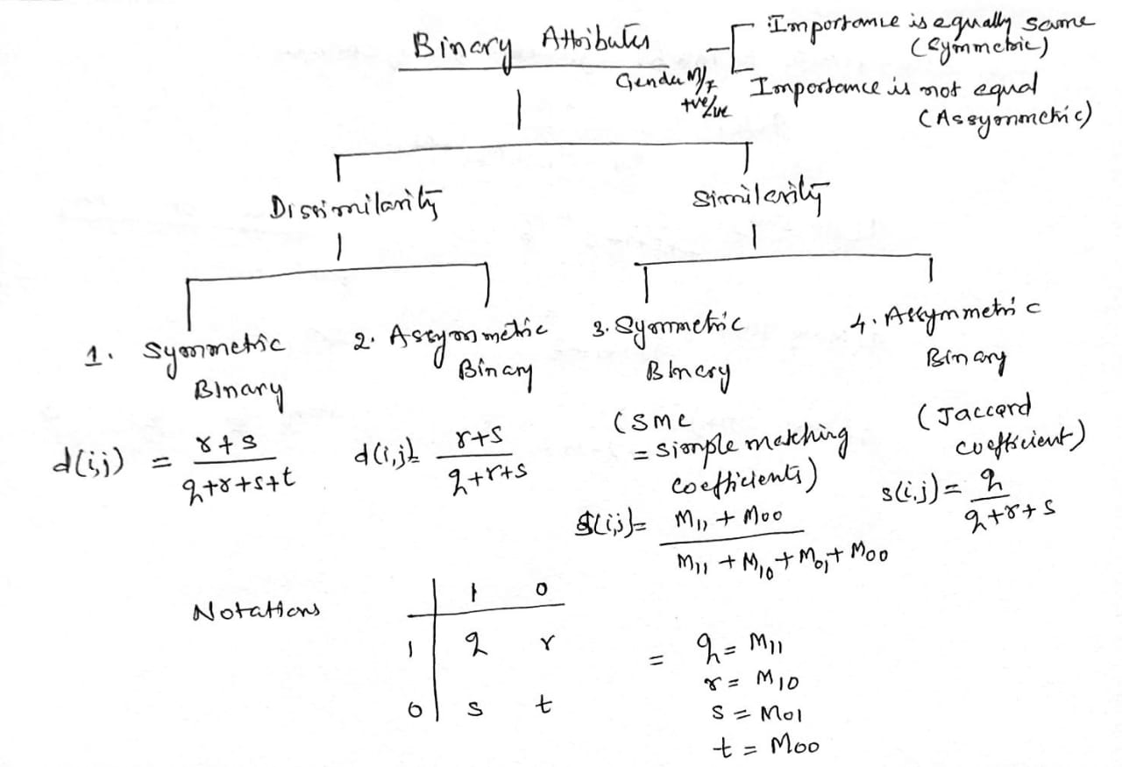
Proximity Measure for Binary Attributes

Slide 34
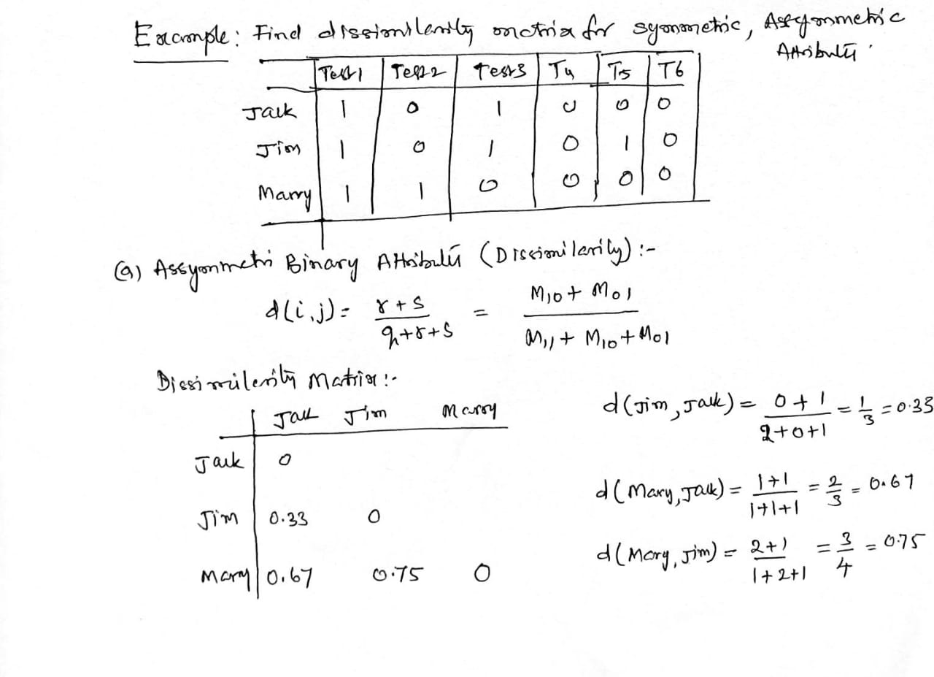
Proximity Measure for Binary Attributes: Example

Slide 35
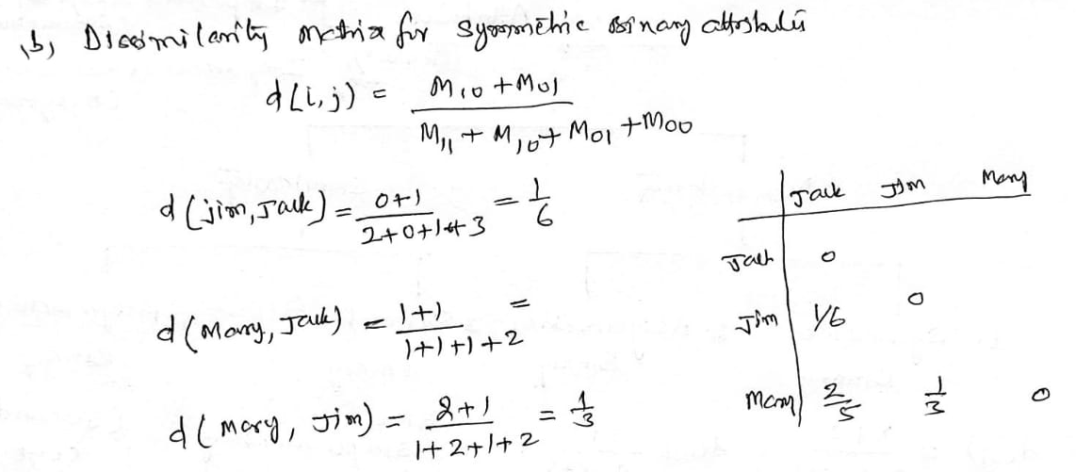
Proximity Measure for Binary Attributes

Slide 36
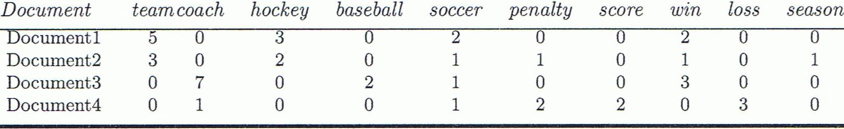
Cosine Similarity
A document can be represented by thousands of attributes, each recording the frequency of a particular word (such as keywords) or phrase in the document.
Other vector objects: gene features in micro-arrays, …
Applications: information retrieval, biologic taxonomy, gene feature mapping, ...
Cosine measure: If d₁ and d₂ are two vectors (e.g., term-frequency vectors), then
cos(d₁, d₂) = (d₁ • d₂) /||d₁|| ||d₂|| ,
where • indicates vector dot product, ||d||: the length of vector d

Slide 37
Example: Find similarity of documents
cos(d₁, d₂) = (d₁ • d₂) /||d₁|| ||d₂|| ,
where • indicates vector dot product, ||d|: the length of vector d
Ex: Find the similarity between documents 1 and 2.
d₁ = (5, 0, 3, 0, 2, 0, 0, 2, 0, 0)
d₂ = (3, 0, 2, 0, 1, 1, 0, 1, 0, 1)
d₁•d₂ = 5*3+0*0+3*2+0*0+2*1+0*1+0*1+2*1+0*0+0*1 = 25
||d₁||= (5*5+0*0+3*3+0*0+2*2+0*0+0*0+2*2+0*0+0*0)^{0.5}=(42)^{0.5} = 6.481
||d₂||= (3*3+0*0+2*2+0*0+1*1+1*1+0*0+1*1+0*0+1*1)^{0.5}=(17)^{0.5} = 4.12
cos(d₁, d₂ ) = 0.94

Slide 38
K- means Clustering
K-Means Clustering is an unsupervised learning algorithm that is used to solve the clustering problems in machine learning or data science. In this topic, we will learn what is K-means clustering algorithm, how the algorithm works, along with the Python implementation of k-means clustering.
The k-means clustering algorithm mainly performs two tasks:
Determines the best value for K center points or centroids by an iterative process.
Assigns each data point to its closest k-center. Those data points which are near to the particular k-center, create a cluster.

Slide 39
k-Means Algorithm
Algorithm: k-Means clustering
Input: D is a dataset containing n objects, k is the number of cluster
Output: A set of k clusters
Steps:
Randomly choose k objects from D as the initial cluster centroids.
For each of the objects in D do
Compute distance between the current objects and k cluster centroids
Expectation: Assign the current object to that cluster to which it is closest.
Maximization: Compute the “cluster centers” of each cluster. These become the new cluster centroids.
Repeat step 2-3 until the convergence criterion is satisfied
Stop

Slide 40
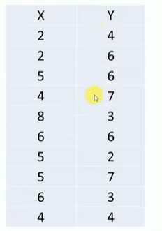
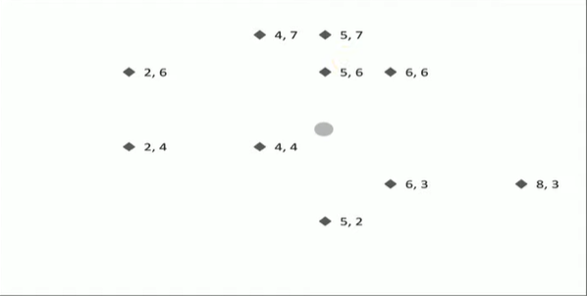
K means clustering Example

Slide 41
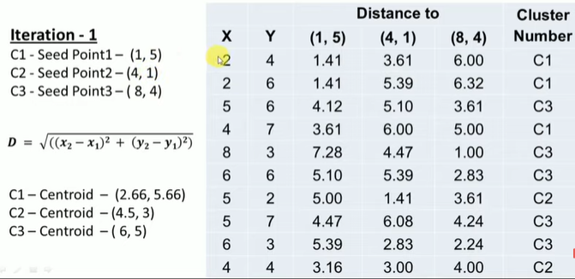

Slide 42
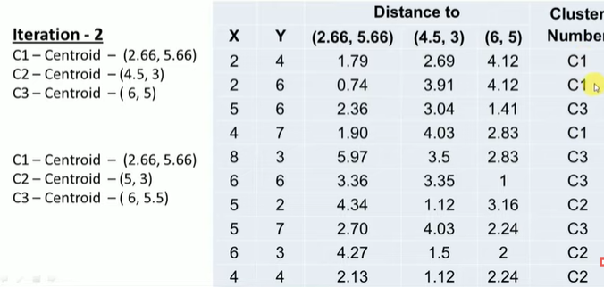

Slide 43
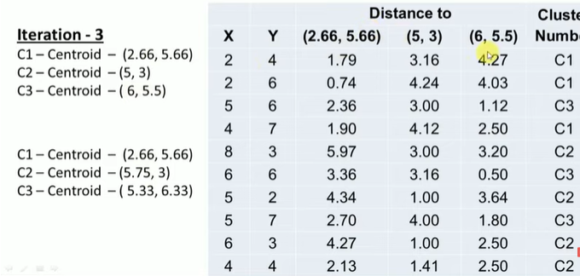

Slide 44
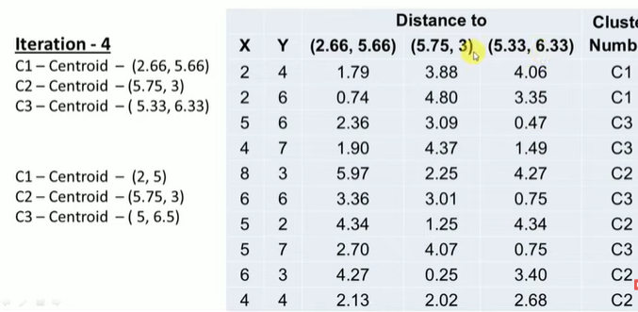

Slide 45
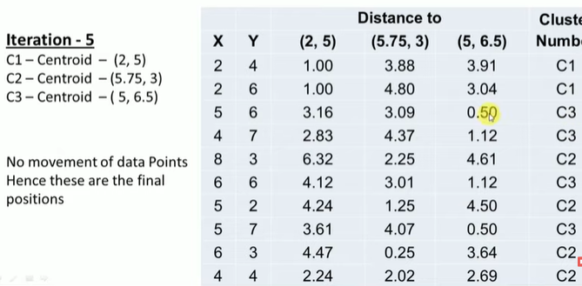
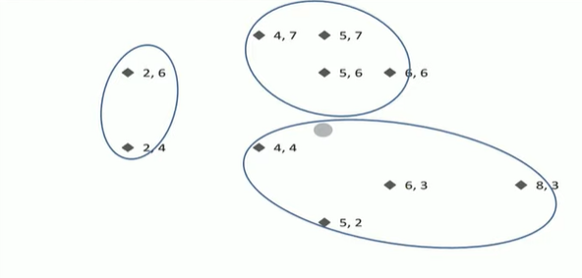

Slide 46
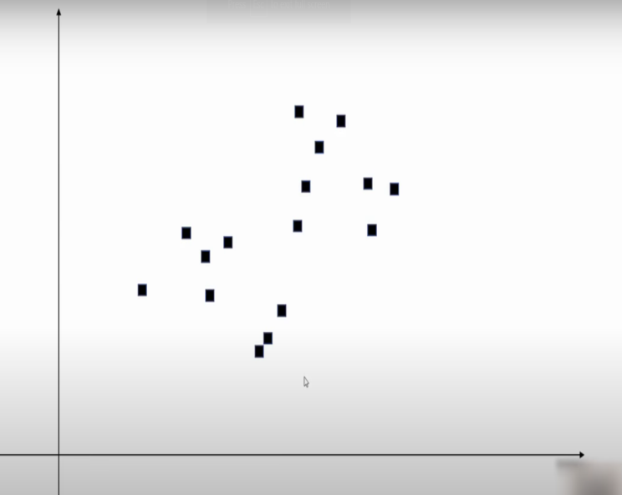
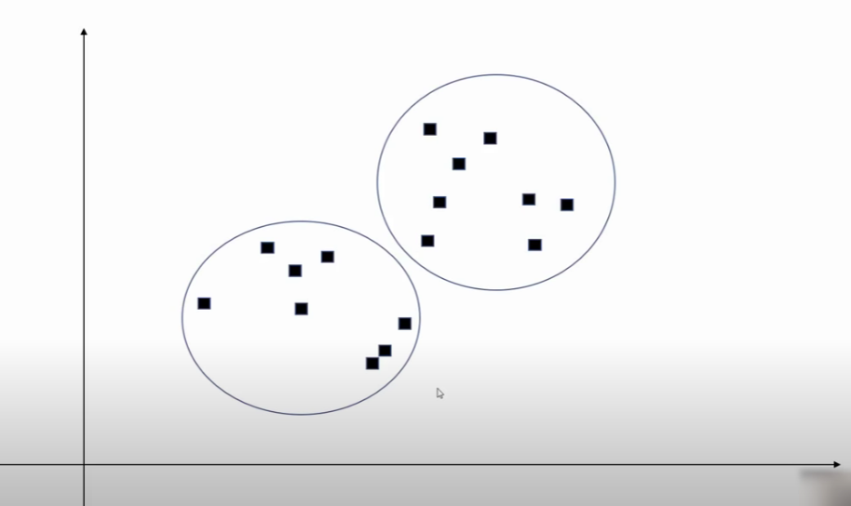
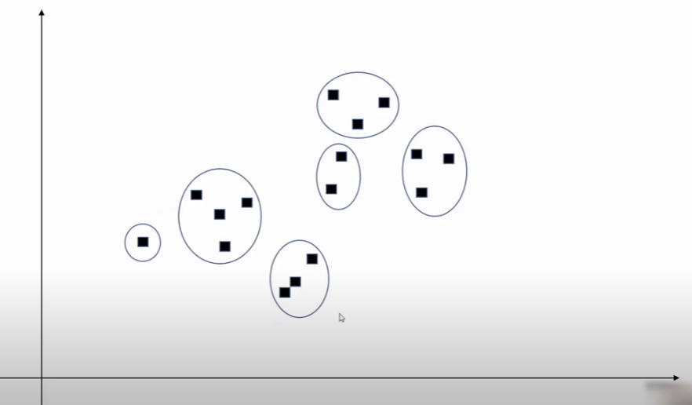
How to decide the number of clusters?

Slide 47
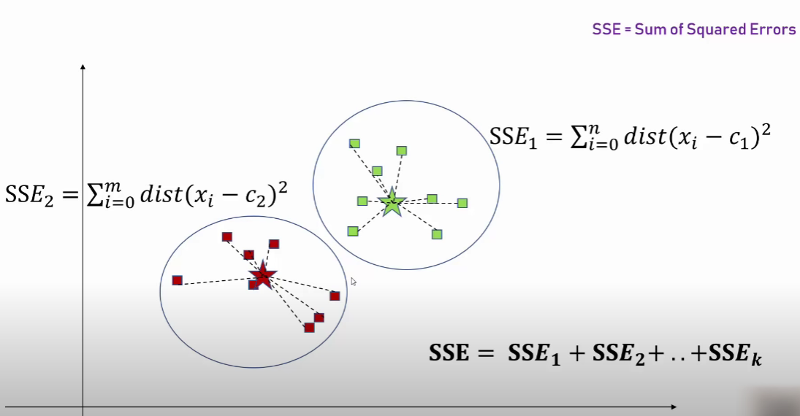
Choosing the Appropriate Number of Clusters elbow method
To perform the elbow method, run several k-means, increment k with each iteration, and record the SSE.
sum of the squared error (SSE): The SSE is defined as the sum of the squared Euclidean distances of each point to its closest centroid. Since this is a measure of error, the objective of k-means is to try to minimize this value.

Slide 48
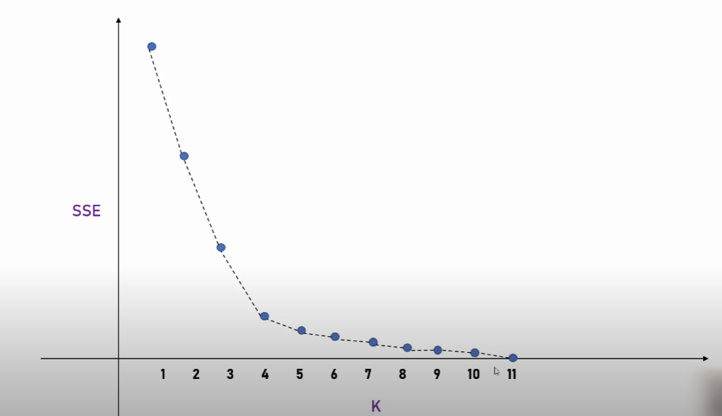
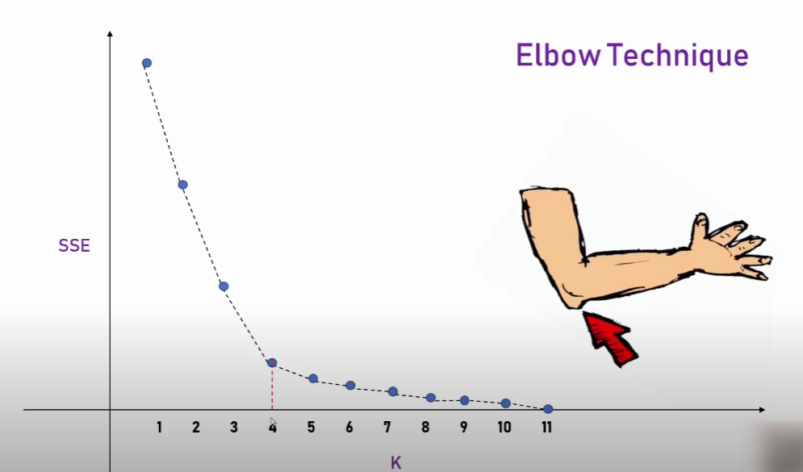
Elbow Plot

Slide 49
K-medoids Algorithm
The k-medoids algorithm is a clustering approach related to k-means clustering for partitioning a data set into k groups or clusters. In k-medoids clustering, each cluster is represented by one of the data point in the cluster. These points are named cluster medoids. A medoid can be defined as the point in the cluster, whose dissimilarities with all the other points in the cluster is minimum.
The dissimilarity of the medoid(Ci) and object(Pi) is calculated by using E = |Pi - Ci|
The k-medoids algorithm requires the user to specify k, the number of clusters to be generated (like in k-means clustering).

Slide 50
K-medoids Algorithm
Algorithm:
1. Initialize: select k random points out of the n data points as the medoids. 2. Associate each data point to the closest medoid by using any common distance metric methods. 3. While the cost decreases: For each medoid m, for each data o point which is not a medoid: 1. Swap m and o, associate each data point to the closest medoid, recompute the cost. 2. If the total cost is more than that in the previous step, undo the swap.

Slide 51
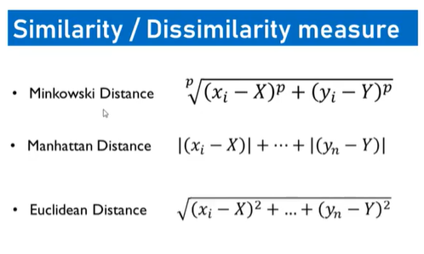
K medoids Clustering

Slide 52


Slide 53
Performance Measures of Clustering

Slide 54
Use cases of the clustering

Slide 55

Use Case 1. Customer segmentation
1. Collection of Data
Some of the features in the data are customer ID, gender, age, income(in K$), and spending score of customers based on spending behavior and nature.
This example aims to divide the customers into several groups and decide how to group customers in clusters to increase customer value and company revenue. This use case is commonly known as customer segmentation.

Slide 57
2. Import libraries
import numpy as np
import pandas as pd
import matplotlib.pyplot as plot
import seaborn as sns
import plotly.express as pxp
import plotly.graph_objs as gph
from sklearn import metrics
from sklearn.metrics import silhouette_score
from sklearn.cluster import KMeans

Slide 58

3. Pre-processing of dataset

Slide 59
Handling Missing values:
Duplicate or missing values may give an incorrect view of the overall statistics of data.
Ignore those tuples
Fill in the missing values
Noisy Data and Removing outliers:
Outliers and inconsistent data points often tend to disturb the model’s overall learning, leading to false predictions.
Binning

Slide 60

Data Transformation

Slide 61
Step 4: Use K-means clustering
it finds all of the different “clusters” and groups them together while keeping them as small as possible. That means that you end up with the most possible customer segments to interpret.
an “elbow” at k=4 tells us that four customer groups are ideal for this dataset.

Slide 62
Step 5: Visualization and interpretation
visualize the findings and interpret it to grow your business.
There are four customer groups with various product orders, spending, and return rate amounts. This allowed the company to clearly see the most favourable customer profile to target.

Slide 63

Use Case 2: News Article Clustering
Step 1: Dataset
The data I am using is roughly 97k news articles that come from the years 2013–2017 and range from roughly 2k-15k characters in length. I store the dataset in a pandas dataframe for analysis, preview shown below.

Slide 64
Data Preprocessing
Eliminate non english articles
Tokenize, lemmatize, and stem words within each article
Concatenate words of each record into a string and convert the entire pandas series into a list of strings
Perform Count Vectorization and remove stop words

Slide 65

Apply K-Means Clustering algorithm
K-Means Clustering algorithm which groups data points into a set amount of clusters based on the point’s location relative to the ‘centroids’.

Slide 66
Now let’s look at the top words in each cluster:
Cluster 0: state, new, year, president, people, nation, one, unit, country, govern
Cluster 1: Trump, president, Donald, would, white, house, campaign, American, Washington, administration, nation
Cluster 2: Trump, republican, party, Donald, democrat, presidential, senate, candidate, GOP, voter, nominee
Cluster 3: one, year, new, first, world, game, live, week, people, make, get, say, work, show
Cluster 4: Clinton, Hillary, Trump, democrat, campaign, Sanders, presidential, election, emails, Bernie, support

Slide 67
Use case 3: Classification of social network users
Each network consists of:
Nodes: The individuals whose network we are building.
Edges: The connection between the nodes. It represents a relationship between the nodes of the network.
The first network that we create is a group of people who work together. This is called a symmetric network because the relationship “working together” is a symmetric relationship: If A is related to B, B is also related to A.

Slide 68

Now we visualize the network.

Slide 69
Apply K nearest neighbor (kNN) or Decision Trees algorithm.
There are 4 classes that are used on Facebook, including photo, status, video and link.
Features and explanation
1 Total liked pages
2 Category
3 The day the submission was published (1-7)
4 Number of people who saw
5 Number of clicks and clicks
6 Number of people who click anywhere in the post
7 Number of likes
8 Number of shares sent
9 Sum of likes, comments and shares
10 Class (Status, Photo, Link, Video)

Slide 70

Use case 4: Cancer Classification
1. Loading the data

Slide 71
2. Normalize Data- scale 0 to 1
3. Training and Testing the data-We perform train, test split on our model
4. Classification-
Now, we use the KNN algorithm
KNeighborsClassifier(n_neighbors = k).

Slide 72

KNN captures the idea of similarity (sometimes called distance, proximity, or closeness)

